Slide 1
TELEFLORA
Plant App Usability Study
1/27/2022
UX Research Team

Slide 2
Table of Contents
Section 1 Study Details
Section 2 Themes
Section 3 Insights & Recommendations

Slide 3
Study Details

Slide 4
Project Background
We are creating a plant selling app, Teleflora, to attract and retain customers in our online system. We noticed that having an app would be an easy and handy tool for the customers to place their orders. So our focus is to create a product that can compete in the market, improve sales, and increase customer satisfaction.

Slide 5
Study Details
Research Questions
Participants
Methodology
How long does it take for a user to select and order a plant in the app?
Are users able to successfully order the plant that they want?
What can we learn from the steps users took to order a plant?
Are there any parts of the plant ordering process where users are getting stuck?
Is the payment process easy for the customer?
5 participants
Participants between the ages of 22-42.
3 male, 2 Female
25 - 30 minutes
India
Unmoderated usability study
Users were asked to order a plant on a low-fidelity prototype

Slide 6
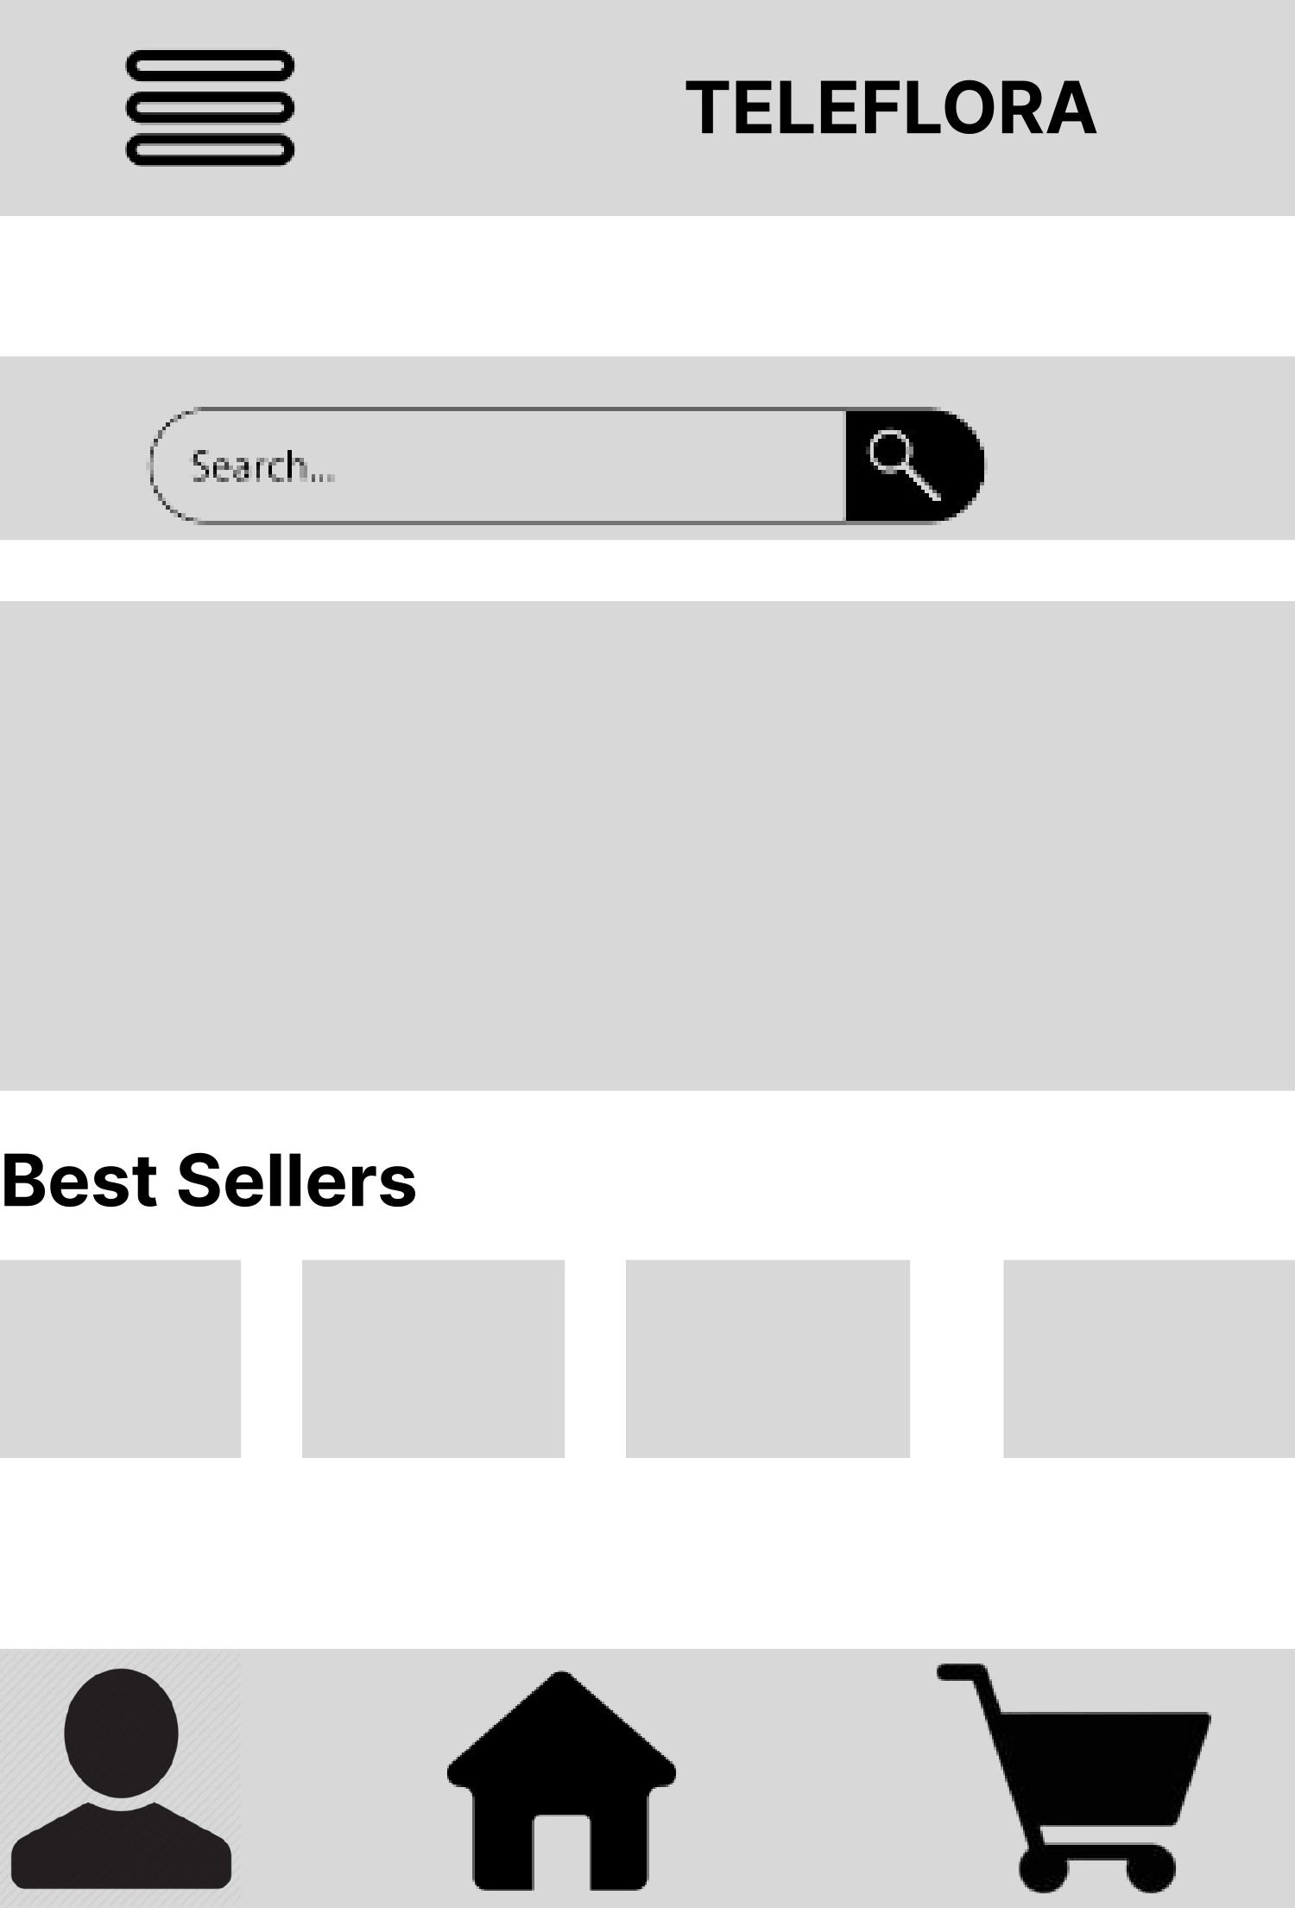
Prototype Tested
The low-fidelity app prototype for Teleflora was tested and can be viewed here.
https://www.figma.com/file/XVsY1zP7NrOxzOAaM47W5c/Untitled?type=design&node-id=0%3A1&t=b6uSlTgj9JJY9grb-1

Slide 7
Themes

Slide 8
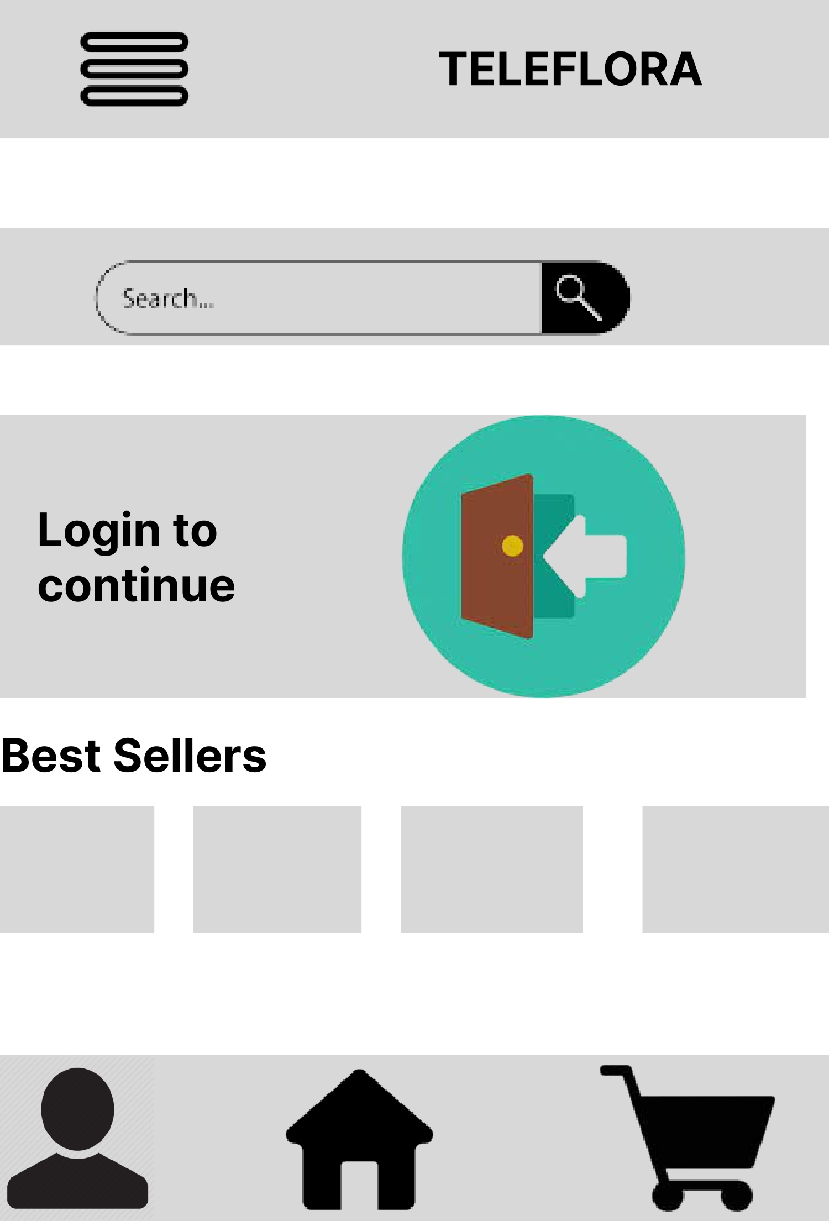
User want to browse through the collection without signing-in
Supporting evidence from the usability study.
4 out of 5 total participants said they wanted to checkout the collection without Signing-in.
“I like the app features, but it asks to sign-in first in order to see the collection. It would have been easier if the app had an option to check its collection out without signing- in.”
— Harshita Jha, Plant lover from Delhi, India.

Slide 9
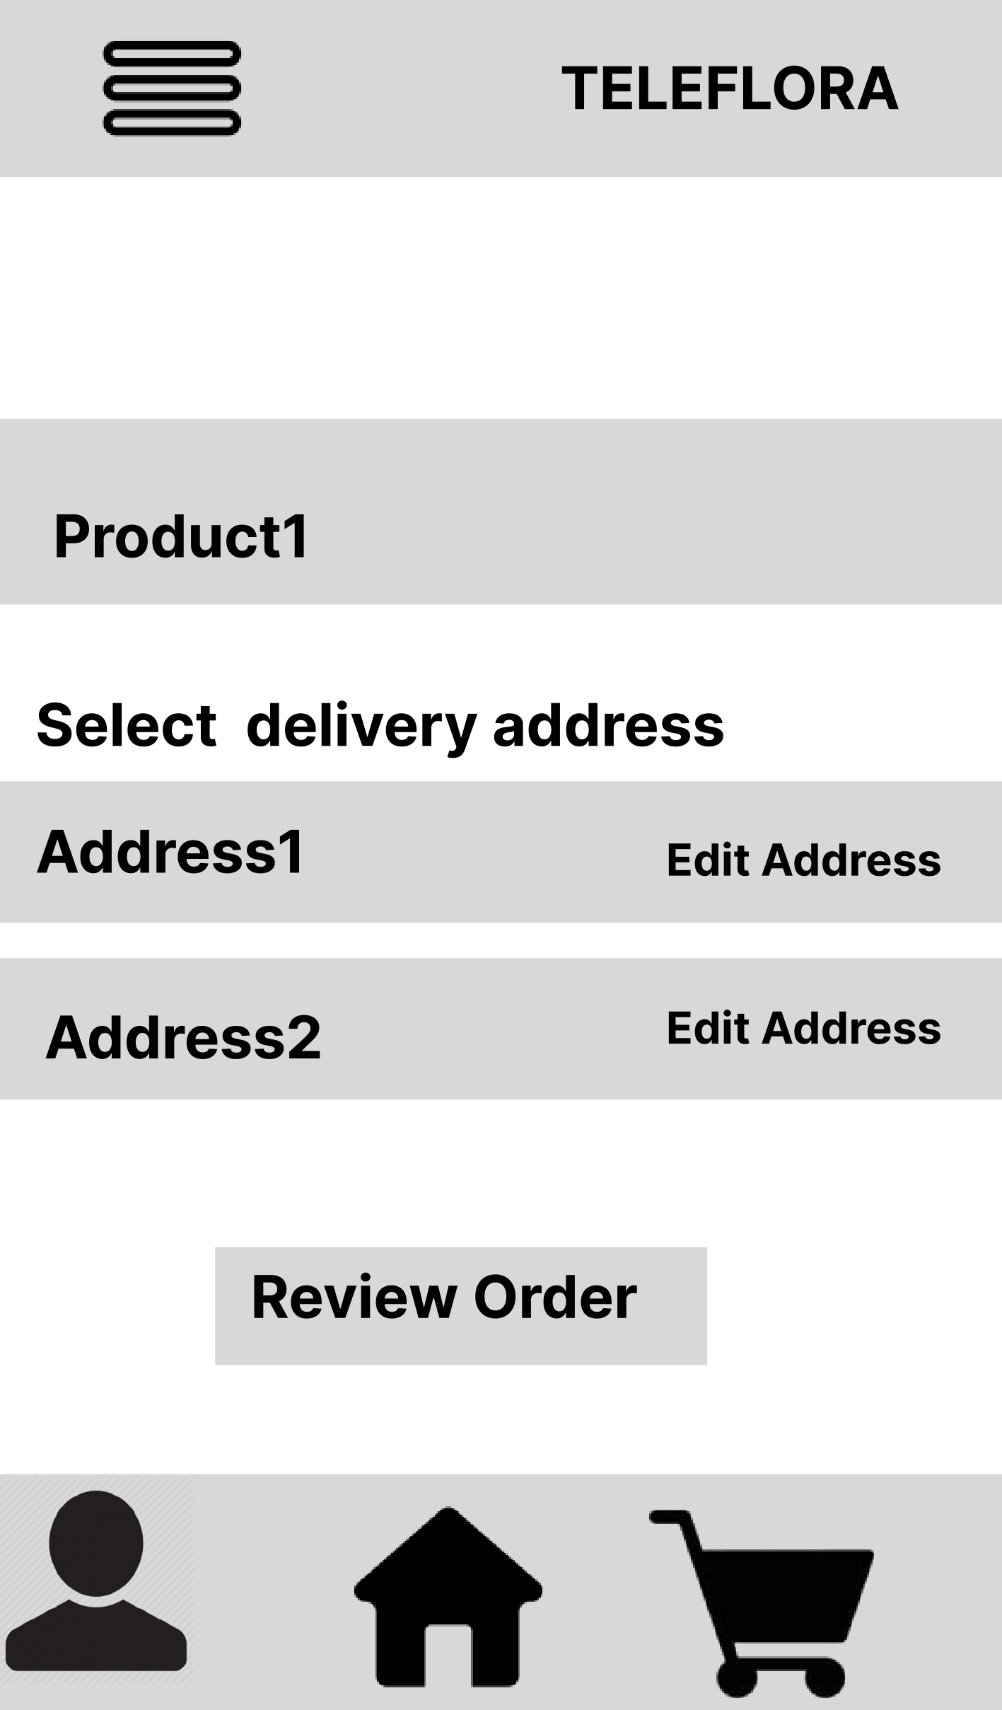
Users felt the need to have a review page before confirmation
Supporting evidence from the usability study.
5 out of 5 total participants said they wanted an option of review page having all the details of the chosen product, before placing the order.
“Right after selcting the payment mode, my order got confirmed. It would be nice to have a reveiw page to show the details related to the product I ordered.”
— Abdul Gaffor, India

Slide 10
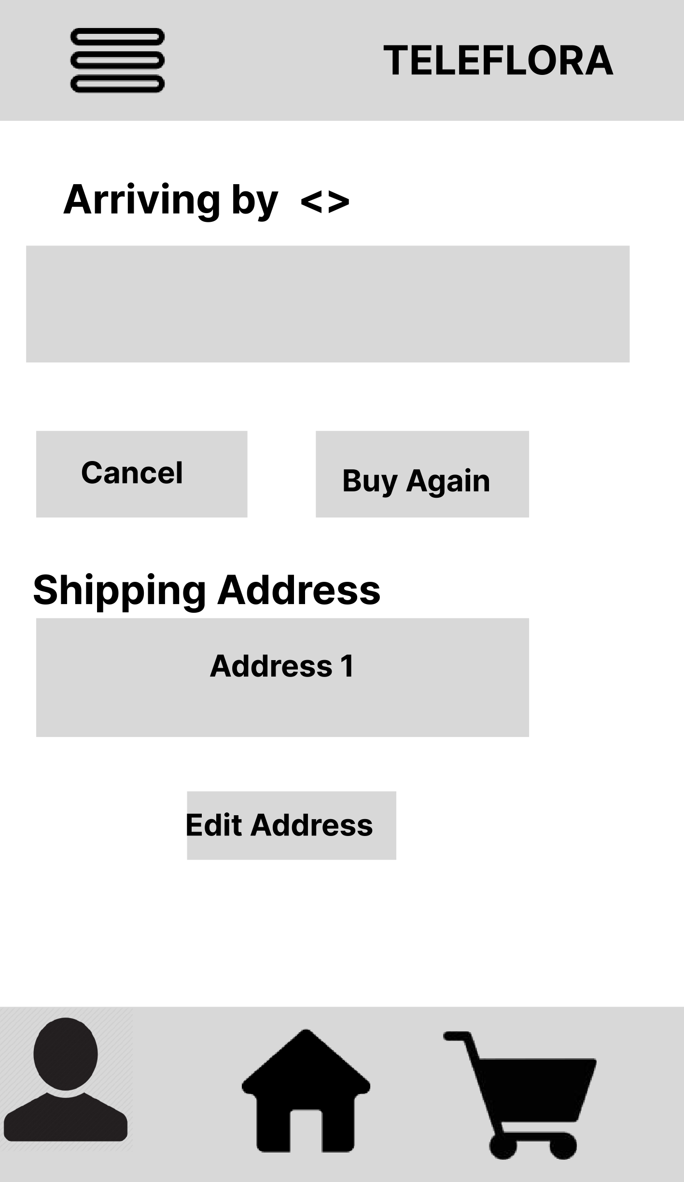
Users felt the need to have an option to change the address after placing the order
Supporting evidence from the usability study.
3 out of 5 total participants said they wanted an option of changing the address even after placing the order because sometimes they want to change it.
“Sometimes, I want to change the address of the procduct delivery after placing the order but there is no such option available. Wish the app had this option.”
— Vidhi Joshi, India

Slide 11
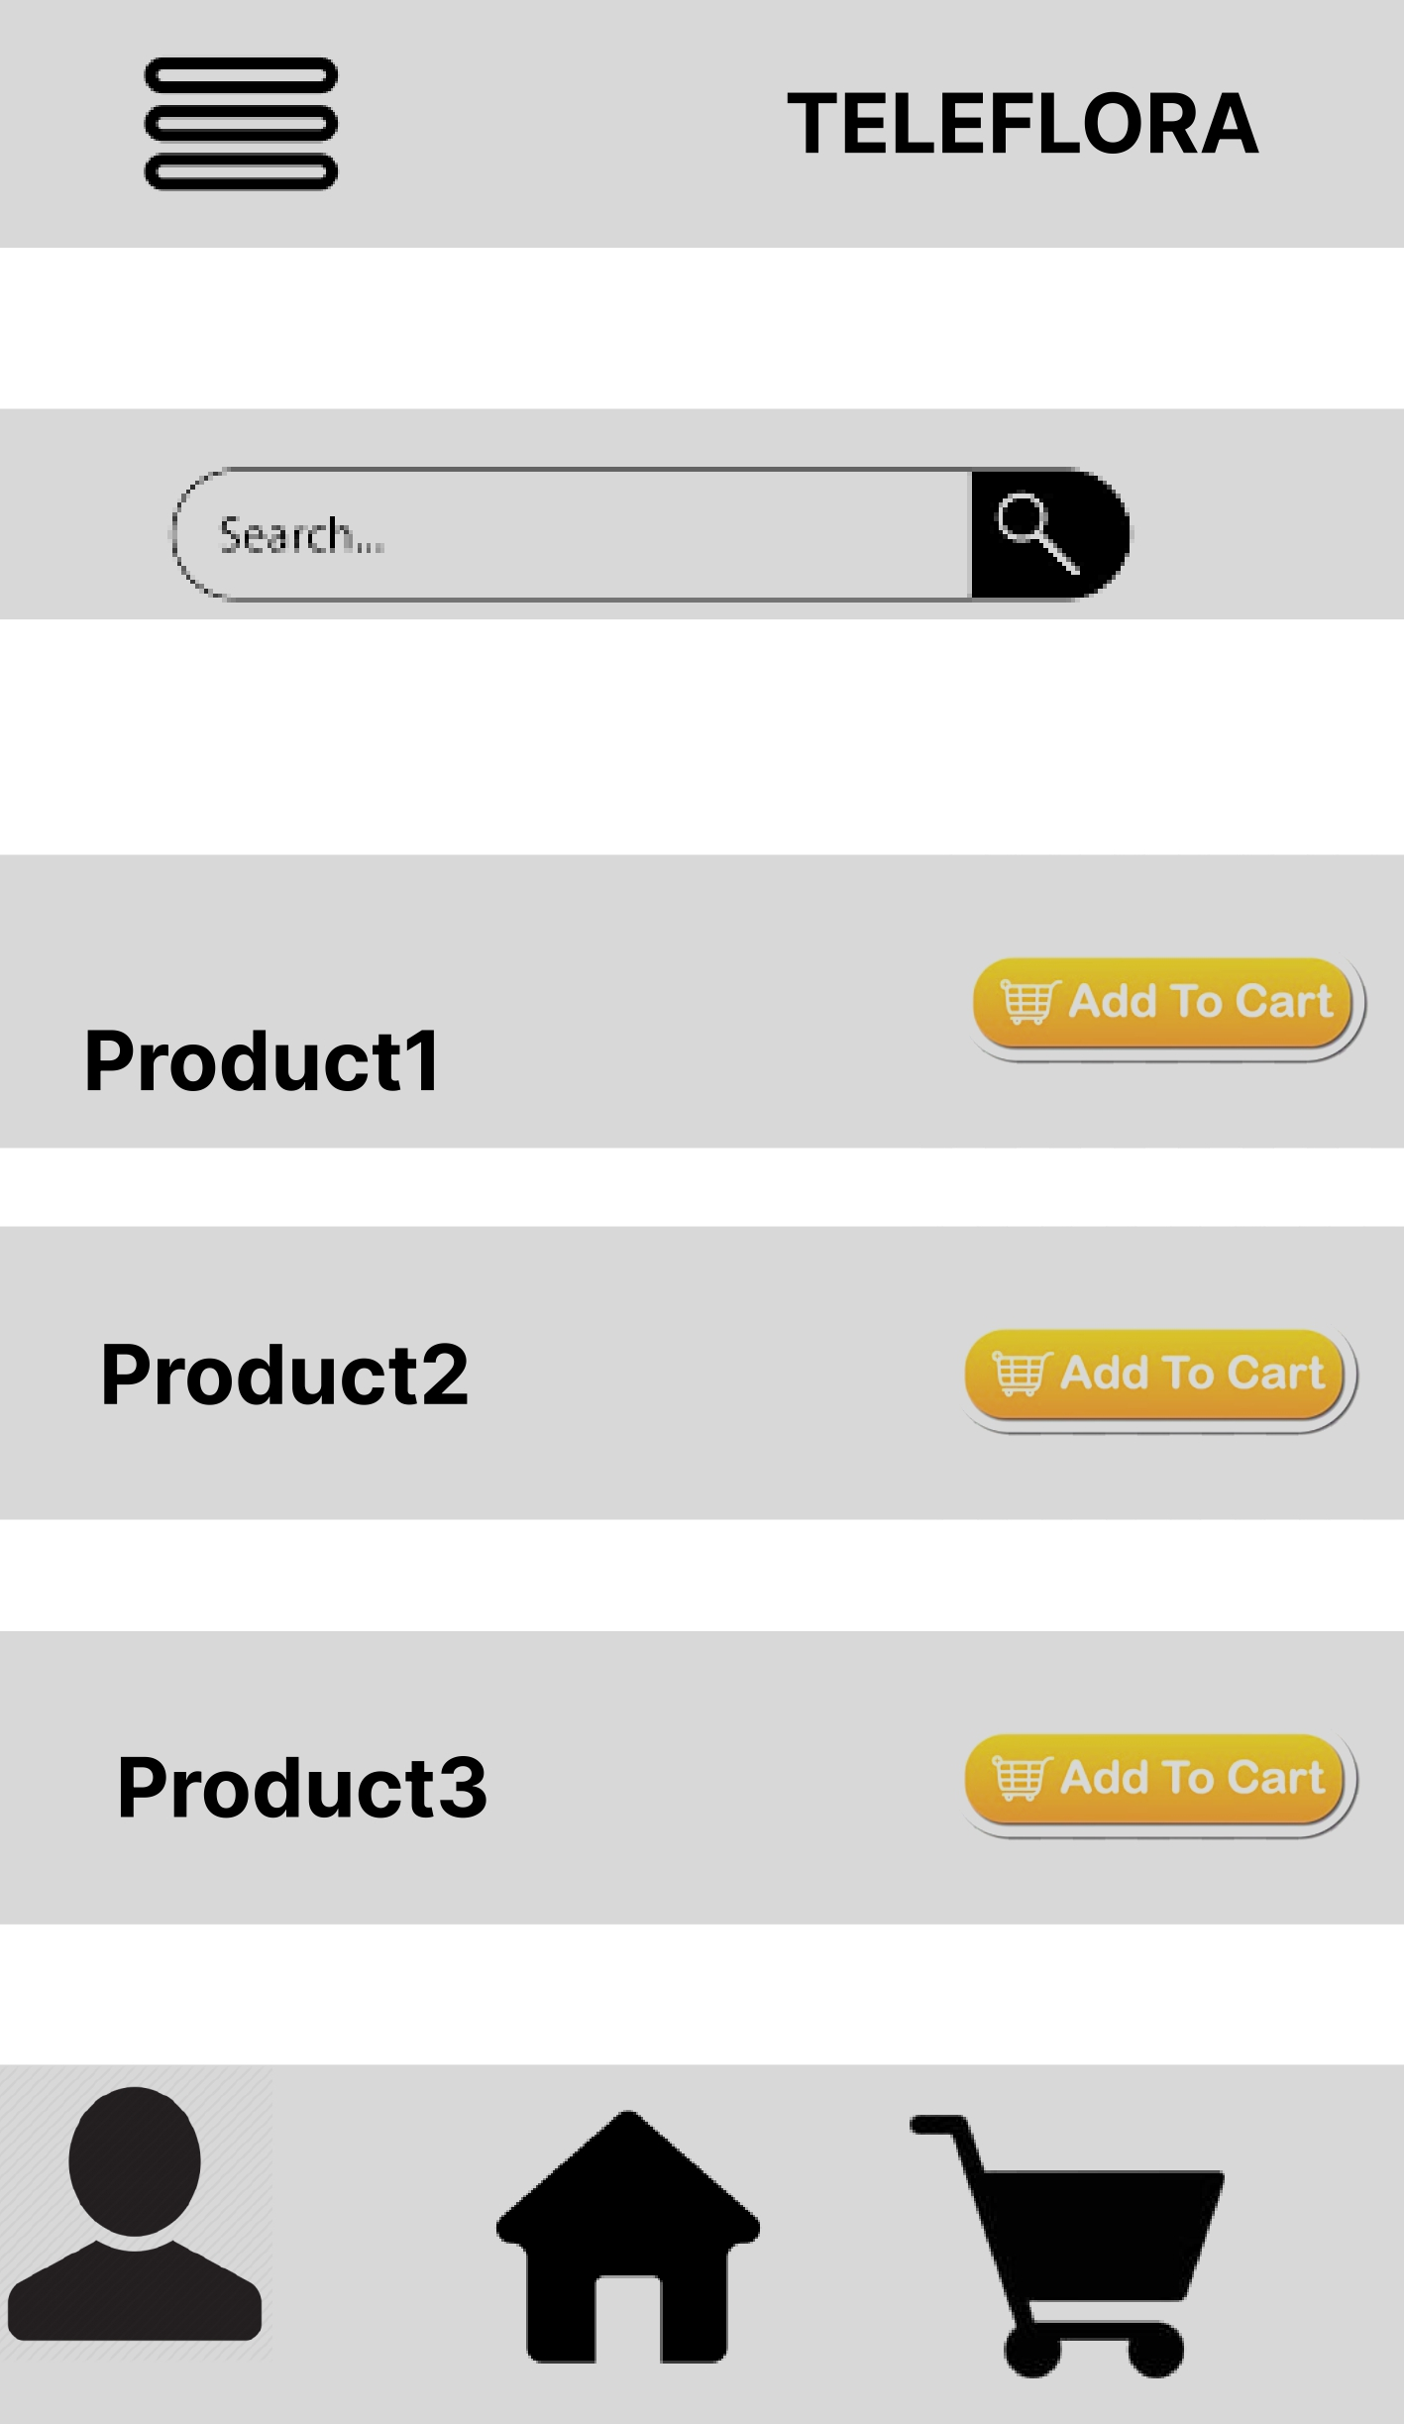
Users want “add to cart” option while browsing through the collection
Supporting evidence from the usability study:
3 out of 5 total participants noted that they would like an option of “ add to cart” while checking out the collection
“I am a plant lover and it is nice to have an app for it. But I wanted to have “ add to cart” option while browisng through the collection, too, as it is already available when you click on the particular item.”
— Aditi Gupta, Plant lover, Minnesota, USA.

Slide 12
Insights & Recommendations

Slide 13
Research insights
Browse without sign-in
Review Page
Address change
Add to cart option
Users need a review page before placing the order to confirm their order details.
Users want an option to change their address even after placing the order.
Users desired to check out the collection without signing-in
Users need an “ add to cart” option while checking out the collection or the products.

Slide 14
Recommendations
Add a “review page” before placing the final order.
Allow users to check out the app’s collection without signing- in.
Add a “change the delivey address” option so that users can change their address if they feel to do so.
Add a “add-to-cart” option while browsing through the collection.

Slide 15
Thank you!

